Slide 1


Building the Future Workforce:
PK–12 Educational Opportunities
in North Baton Rouge
Carla Powell Lewis
District 3 School Board Member & SOLES Founder

Slide 2
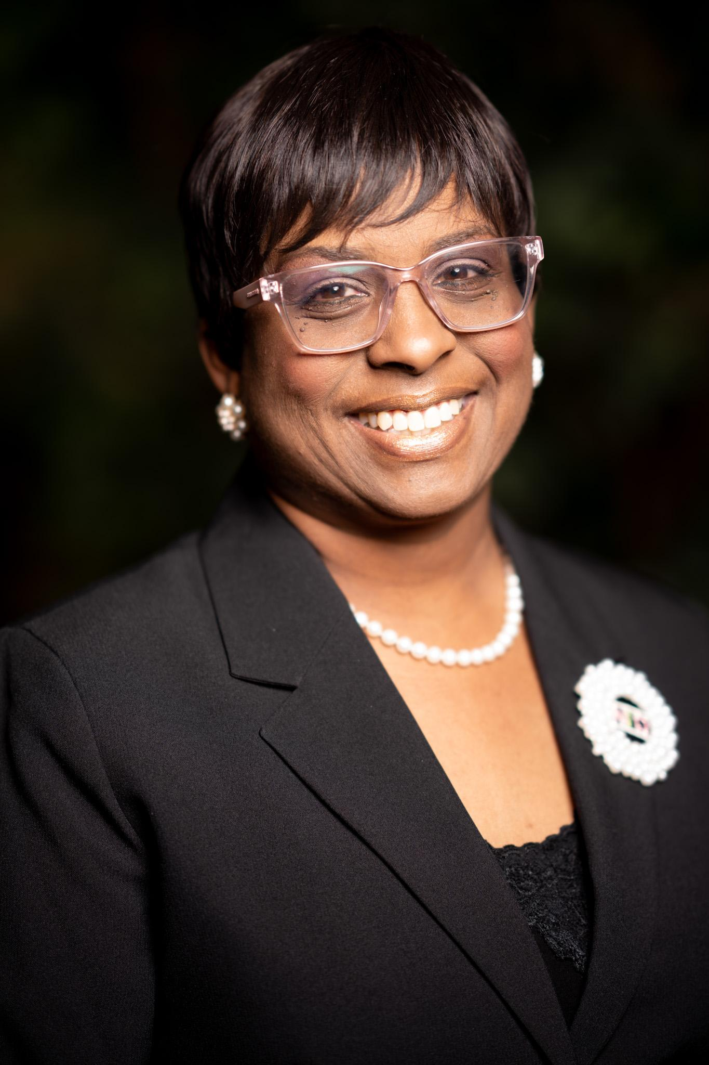
Who Is Carla Powell Lewis?
Daughter. Mom. Wife. Educator. Woman of God. Community Advocate. Dancer.
District 3 School Board Member, East Baton Rouge Parish
Immediate Past President, EBR School Board
Founder & Lead Consultant, Spirit of Excellence Learning Systems (SOLES)
20+ years as a Social Studies educator & instructional leader
National NAUW Woman of the Year (2024)
Hunt Institute Early Learning National Fellow (2024–25)
Advocate for teacher support, student success, and community engagement

Slide 3
Building the Future Workforce in North Baton Rouge
Why This Matters
Students of today = workforce of tomorrow
Early literacy & math = foundation for workforce readiness
Businesses have a role to play in shaping student success

Slide 4

East Baton Rouge Parish PK–12 Snapshot
80 public schools (20 charter, 60 traditional)
40,000+ students
80% minority, 80% low socioeconomic
Literacy & math proficiency below state averages

Slide 5
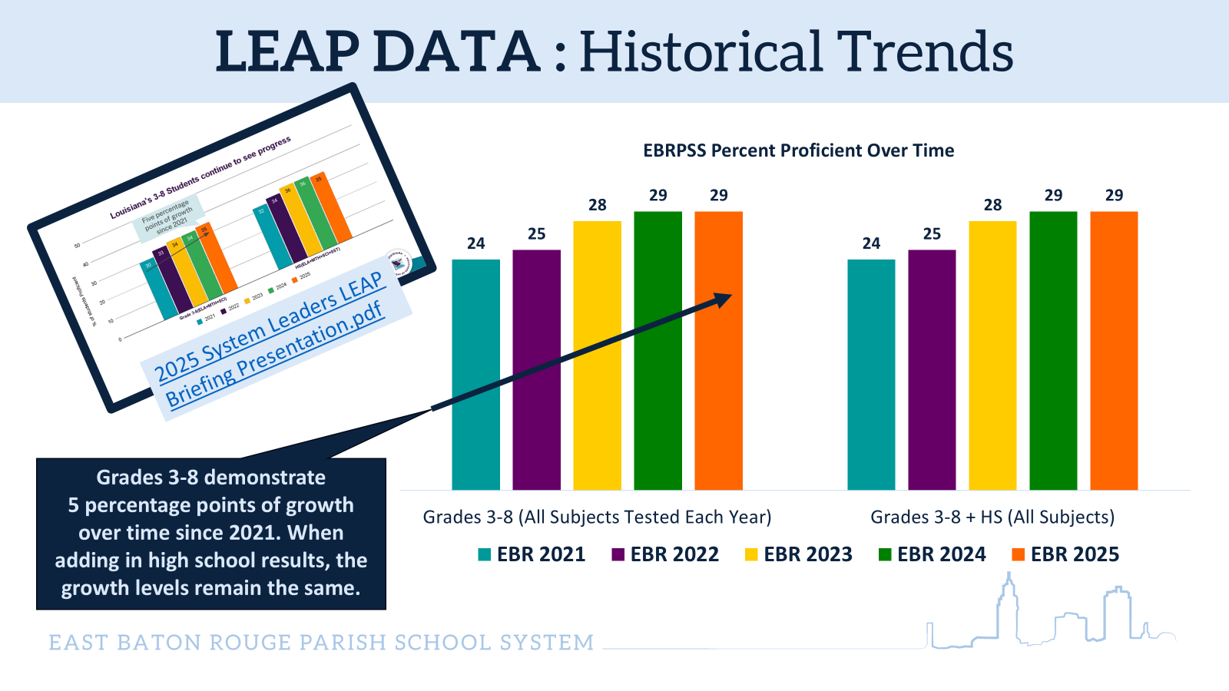

Slide 6
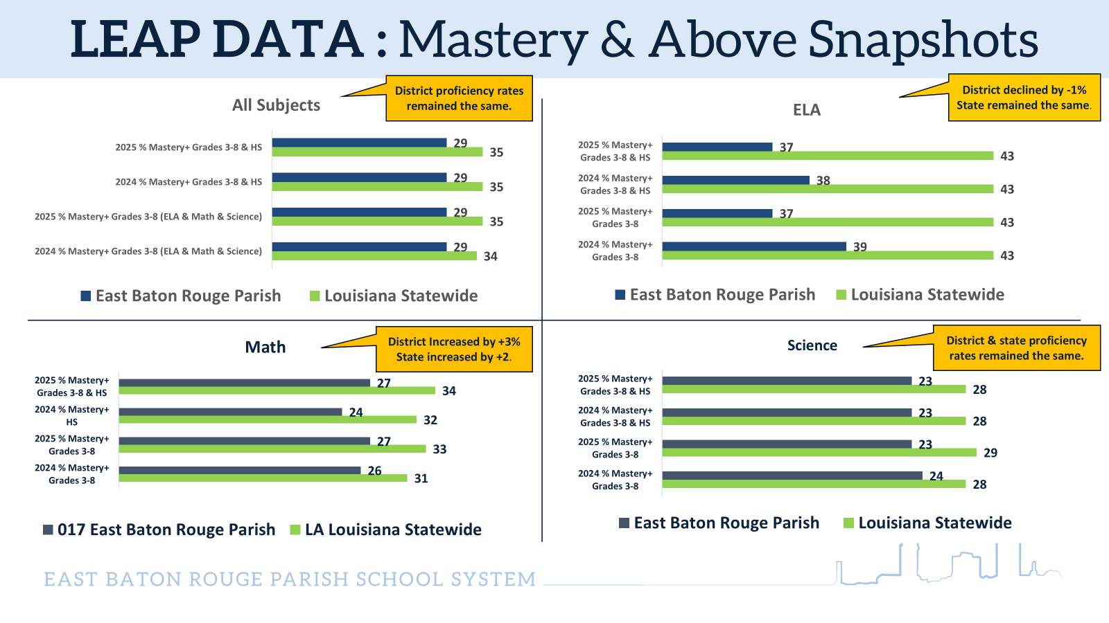

Slide 7
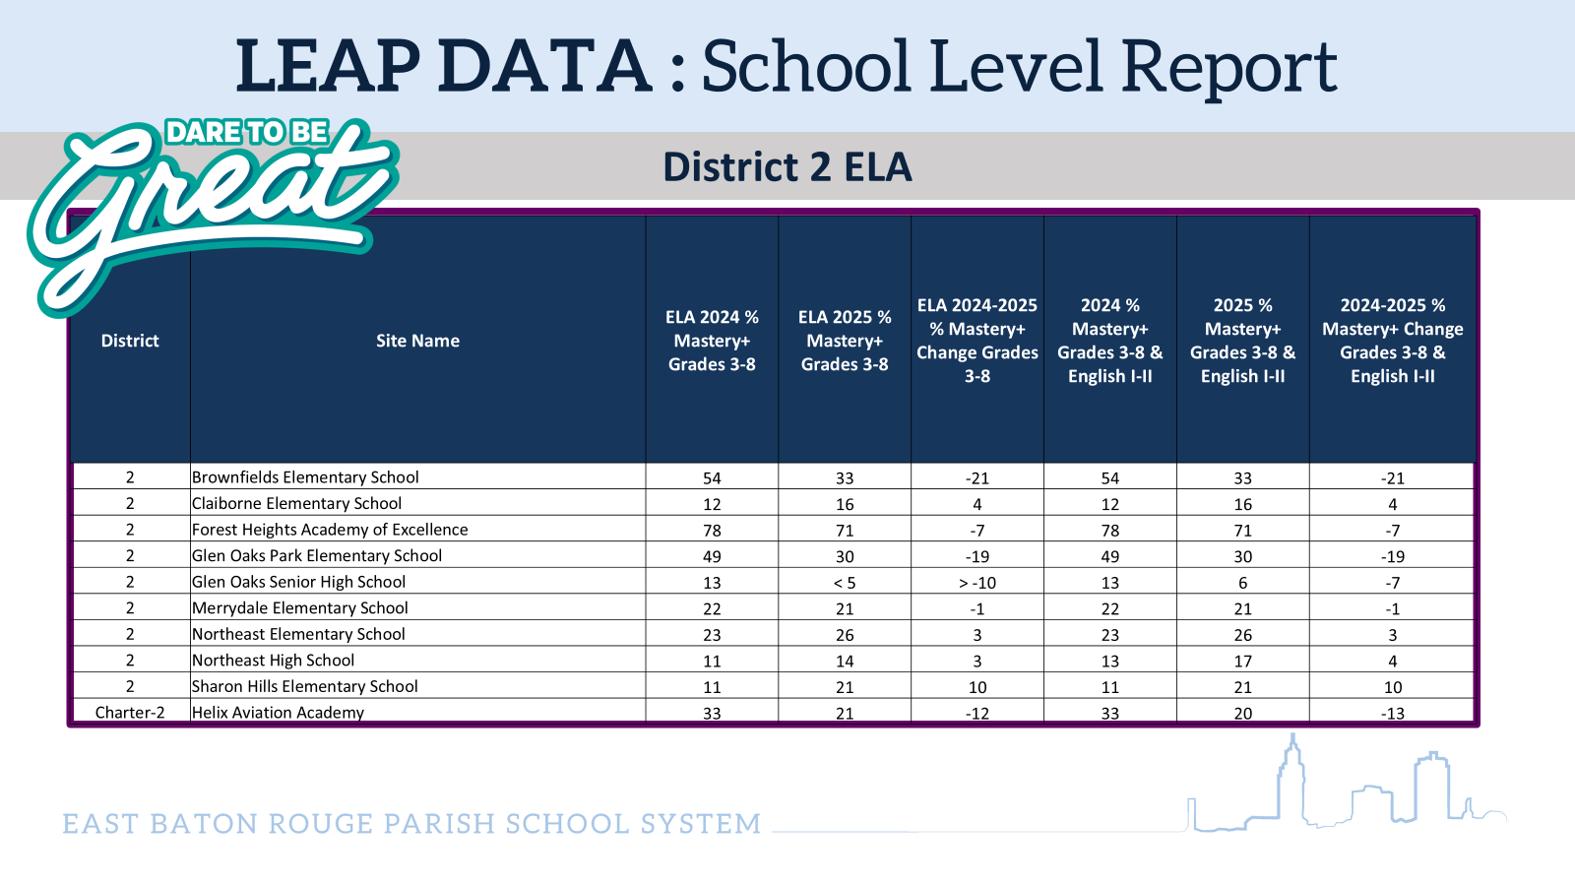

Slide 8
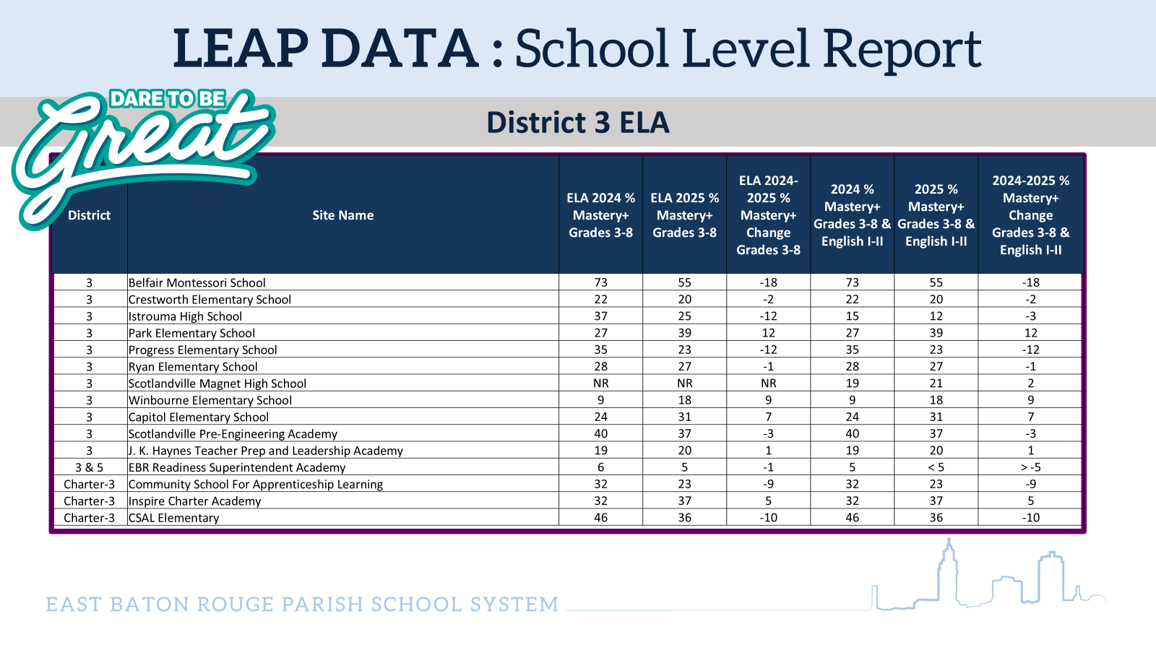

Slide 9
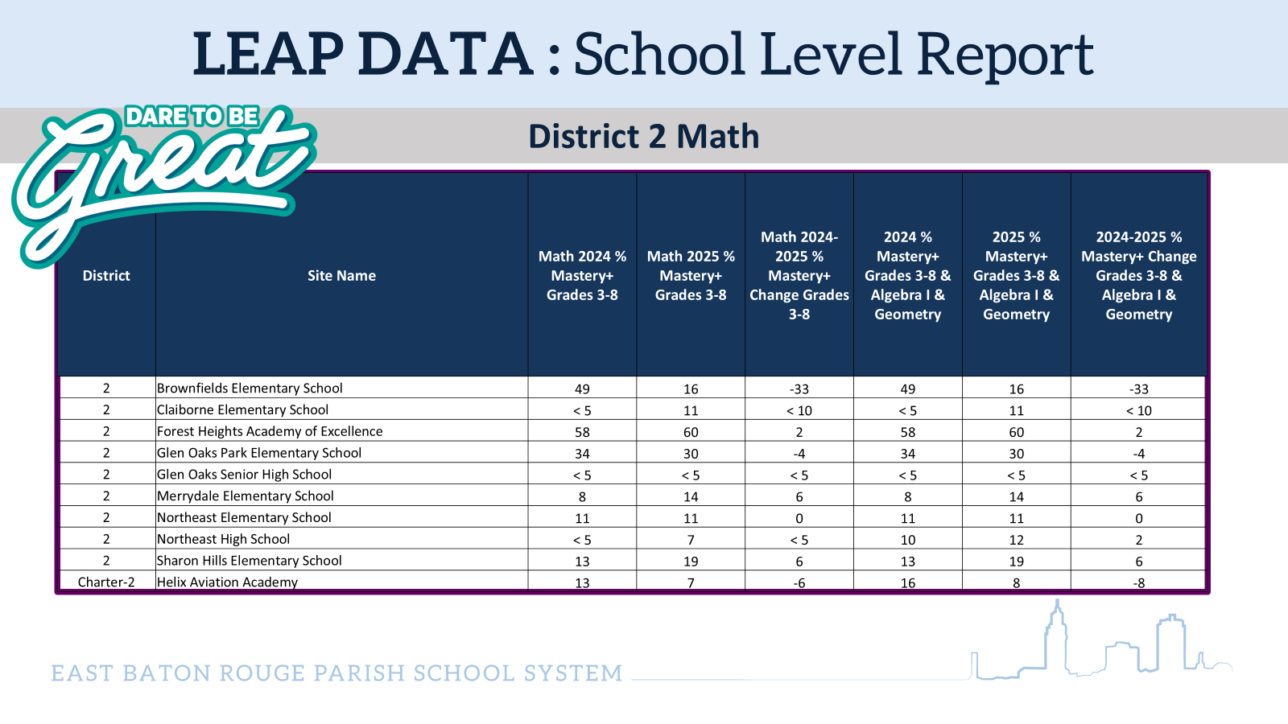

Slide 10
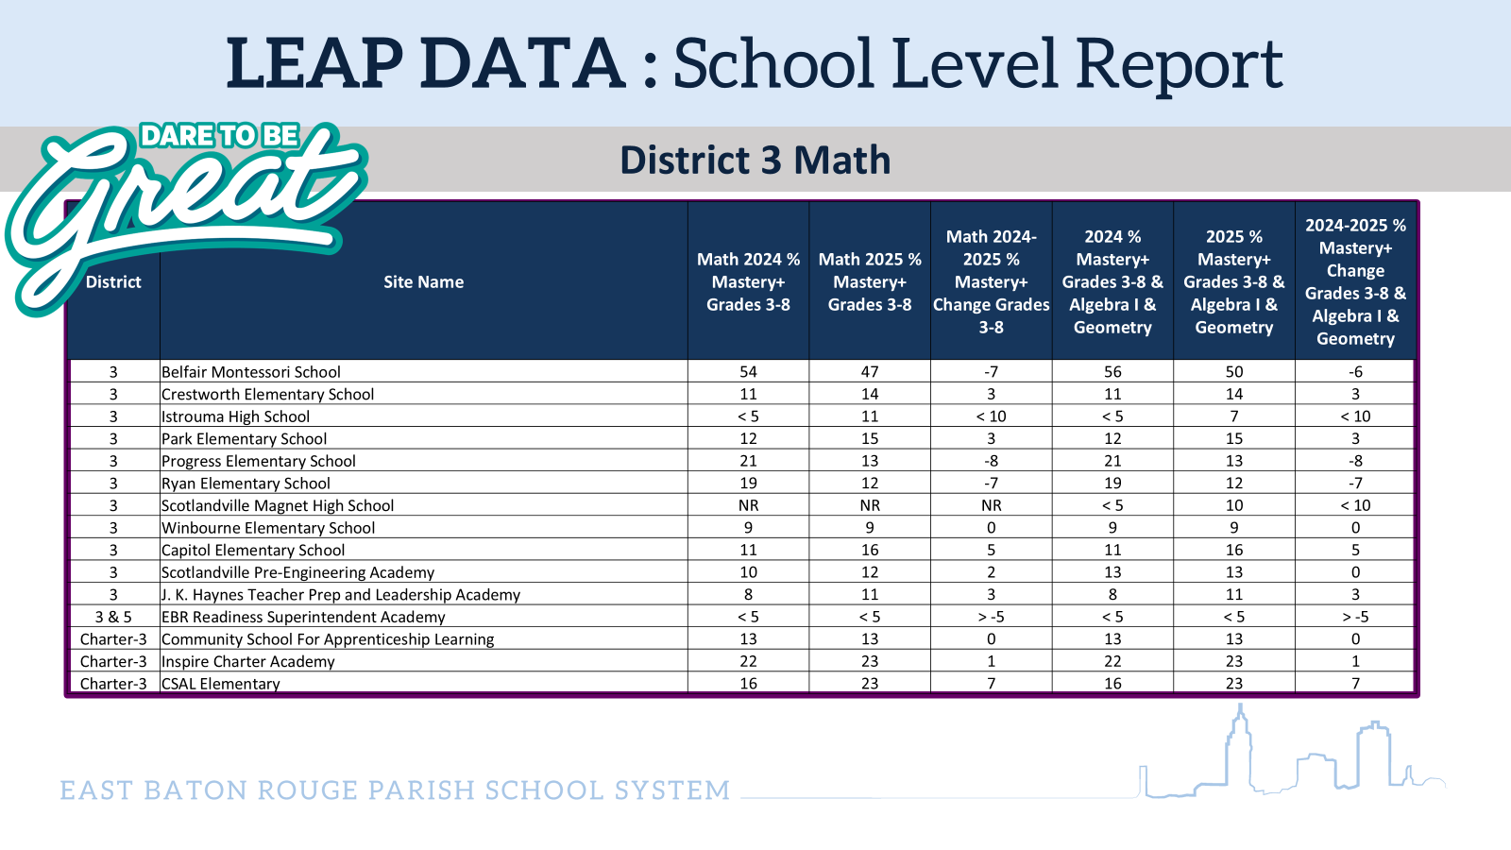

Slide 11
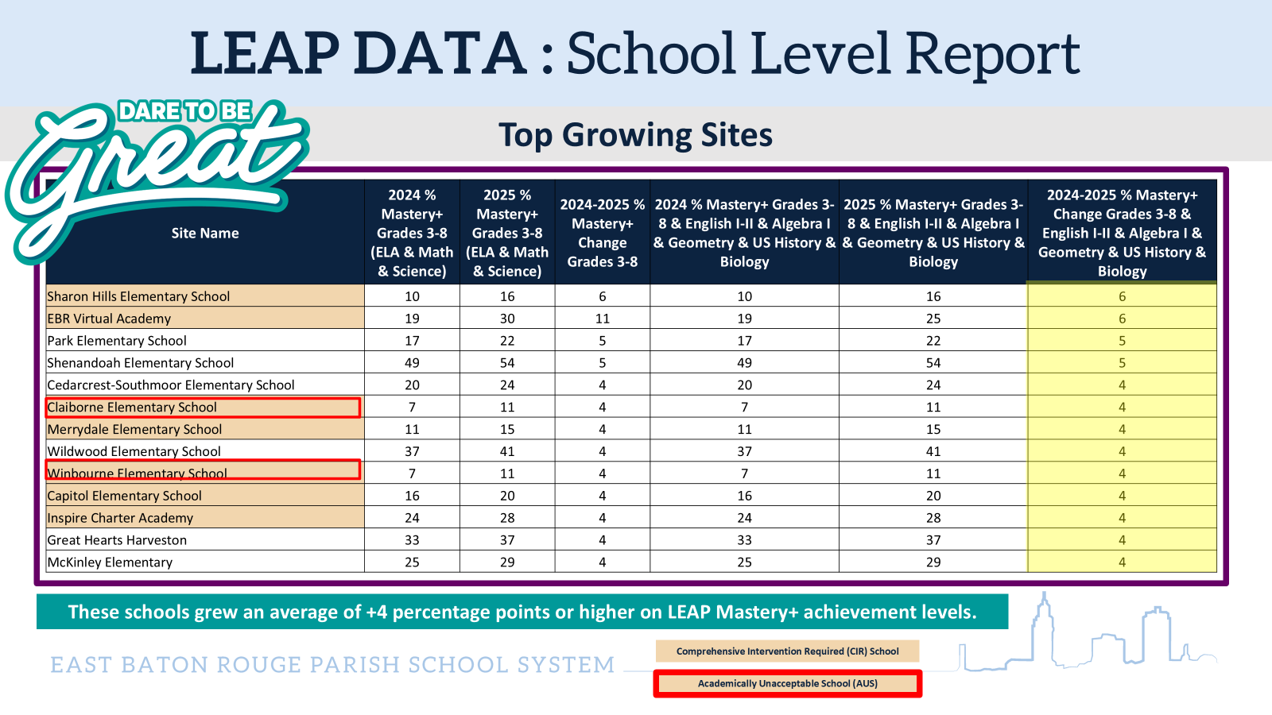

Slide 12


Slide 13

The Workforce Connection
Skills gaps begin early
Strong schools = strong economy
Literacy & numeracy → workforce readiness

Slide 14




Opportunities Of Support
Spirit Of Excellence Learning Systems (SOELS)
Instructional coaching
Customized training presentations for small businesses
AMIKids
Youth development & workforce readiness
VIPS (EBR Schools)
Mentoring, reading/math support, volunteers
Career Fairs & Job Shadowing
Early exposure to careers
EBR Schools Foundation
Philanthropy & Fundraising

Slide 15
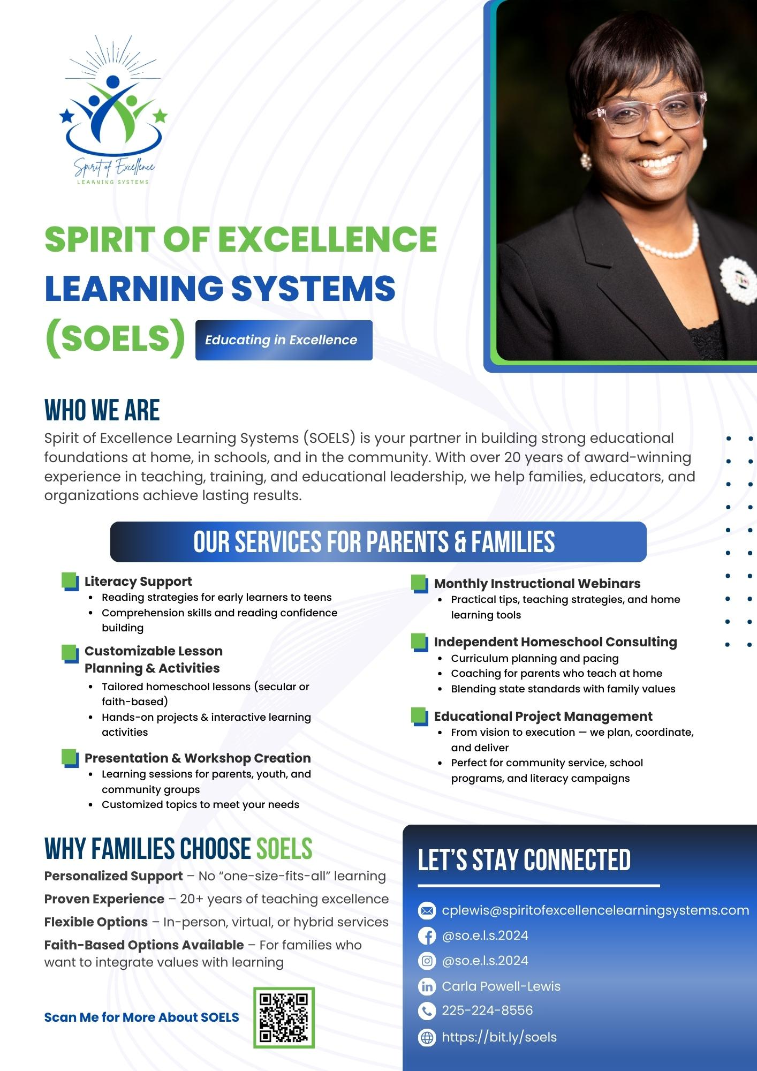


Slide 16



Slide 17


Slide 18
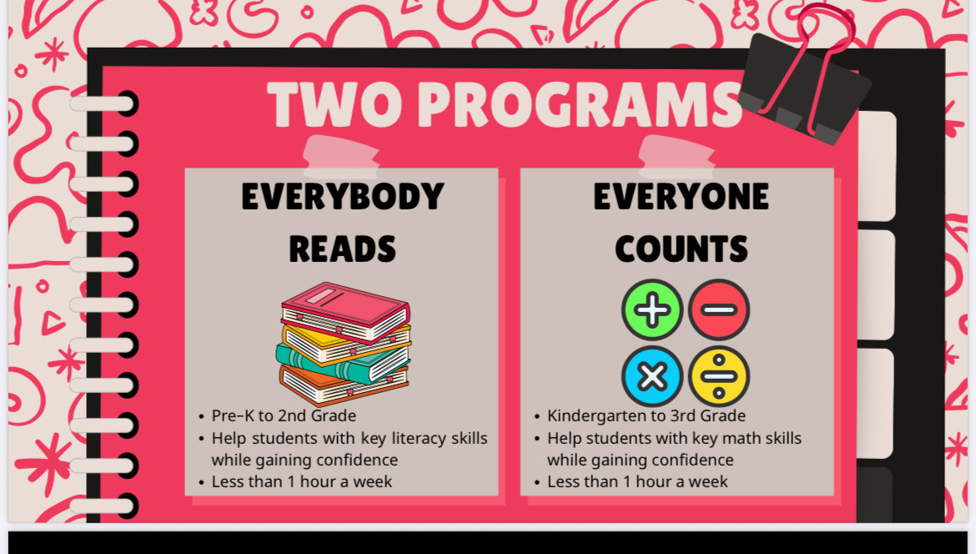

Slide 19


Slide 20
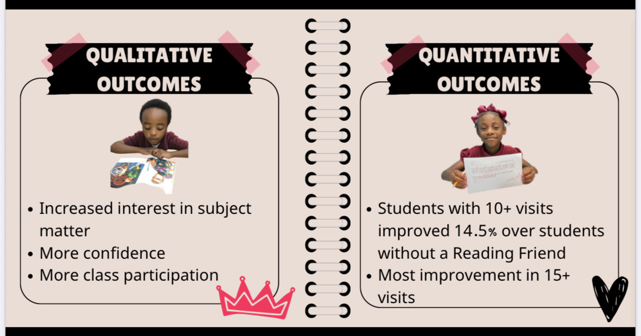

Slide 21


Slide 22



Slide 23
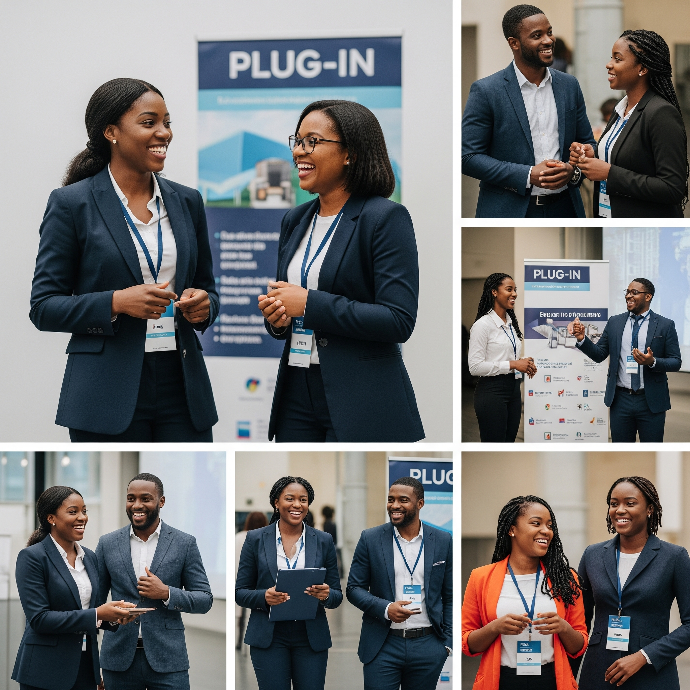
How Businesses Can Plug In
Join VIPS as mentors/tutors
Host job shadowing days
Speak at career fairs
Sponsor enrichment programs
Partner with SOELS for workforce-focused training

Slide 24
Reflection for Members
Which program could your business support this year?
What workforce skills do you wish students had when they graduate?

Slide 25

Call to Action
Invest in NBR’s students = invest in NBR’s economy
Let’s prepare our future leaders together
Connect with me today for resources & next steps

Slide 26
Pop Quiz!
True or False: The workforce readiness gap begins in early grades with literacy and math.
Fill in the Blank: The VIPS program allows businesses to ________.
Multiple Choice: Which program focuses on youth development and workforce readiness?
a) AMIKids
b) SOELS
c) None of the above
Short Answer: Name one way businesses can support PK–12 students.
Bonus: What does SOELS provide for small businesses?

Slide 27
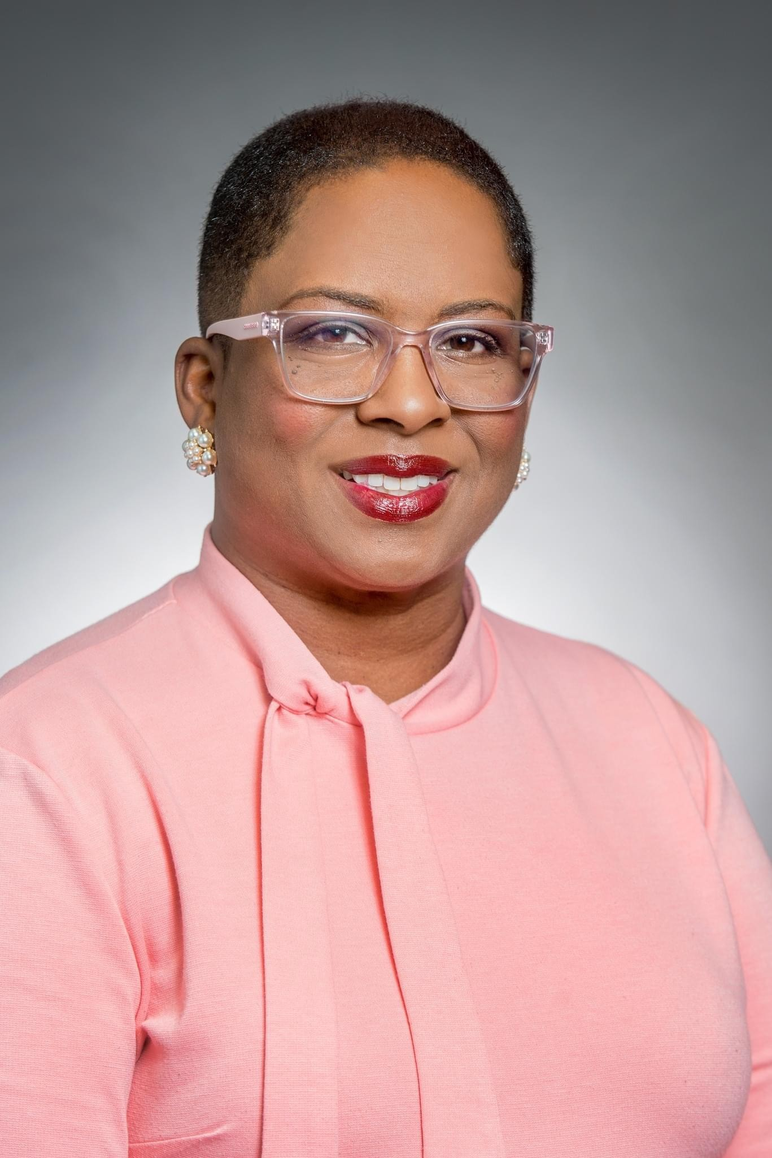
Thank You!!!!
Carla Powell Lewis
East Baton Rouge Parish School Board Member, District 3
Founder, Spirit of Excellence Learning Systems (SOELS)
📧 cpowell3@ebrschools.org | cplewis@spiritofexcellencelearningsystems.com
📱 225-620-7274 | 225-224-8556
🌐 http://bit.ly/soels

